Slide 1
AstroEngr 331X
Payloads:
Visible, IR and SAR Imagery
May 2024

Slide 2
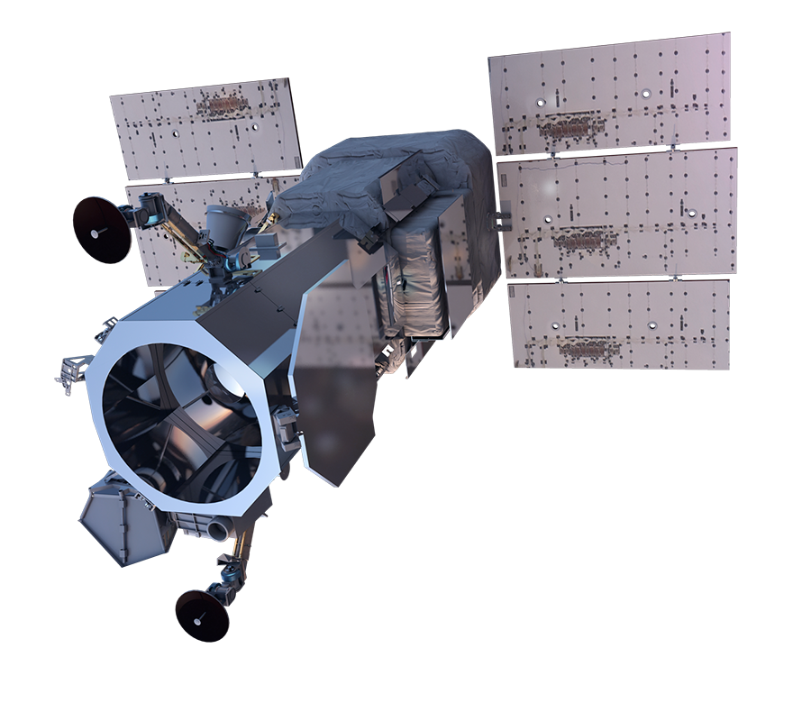
Commercially available imagery
Worldview-3
Very high-resolution
Panchromatic 31 cm
Visible & near-infrared 1.24 m
Short-wave infrared 3.7 m
CAVIS 30 m
Spectral diversity
4 standard VNIR colors: blue, green, red, near-IR1
4 added VNIR colors: coastal, yellow, red edge, and near-IR2
8 SWIR bands: Penetrates haze, fog, smog, dust, and smoke
12 CAVIS bands: Maps clouds, ice and snow, corrects for aerosol and water vapor
Notes:
CAVIS = Clouds, Aerosols, Vapors, Ice & Snow. Monitor atmosphere and provide data to improve other high-res imagery when imaging through haze, soot, dust, etc.
VNIR = Visible and Near Infrared
Worldview 3 can collect up to 680,000 km^2 of imagery per day.

Slide 3
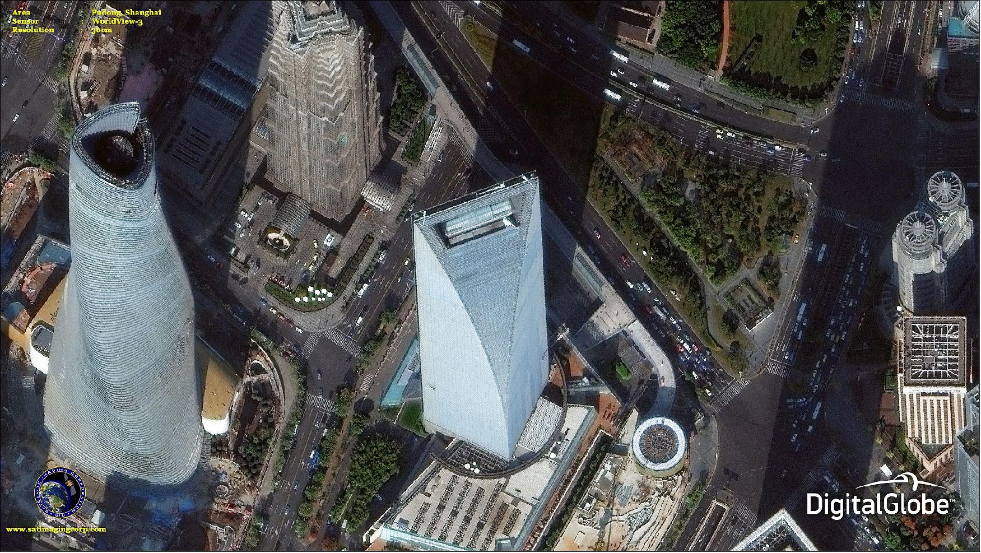
30 cm Resolution, Shanghi

Slide 4
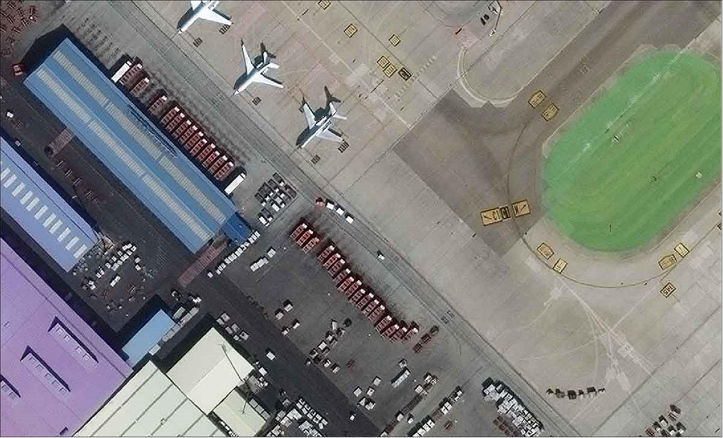
31 cm Resolution, Madrid Airport

Slide 5
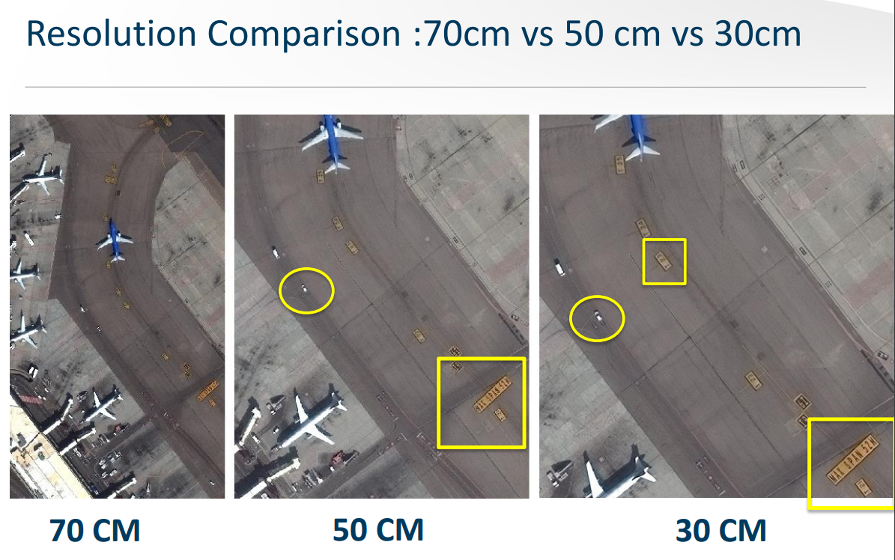

Slide 6
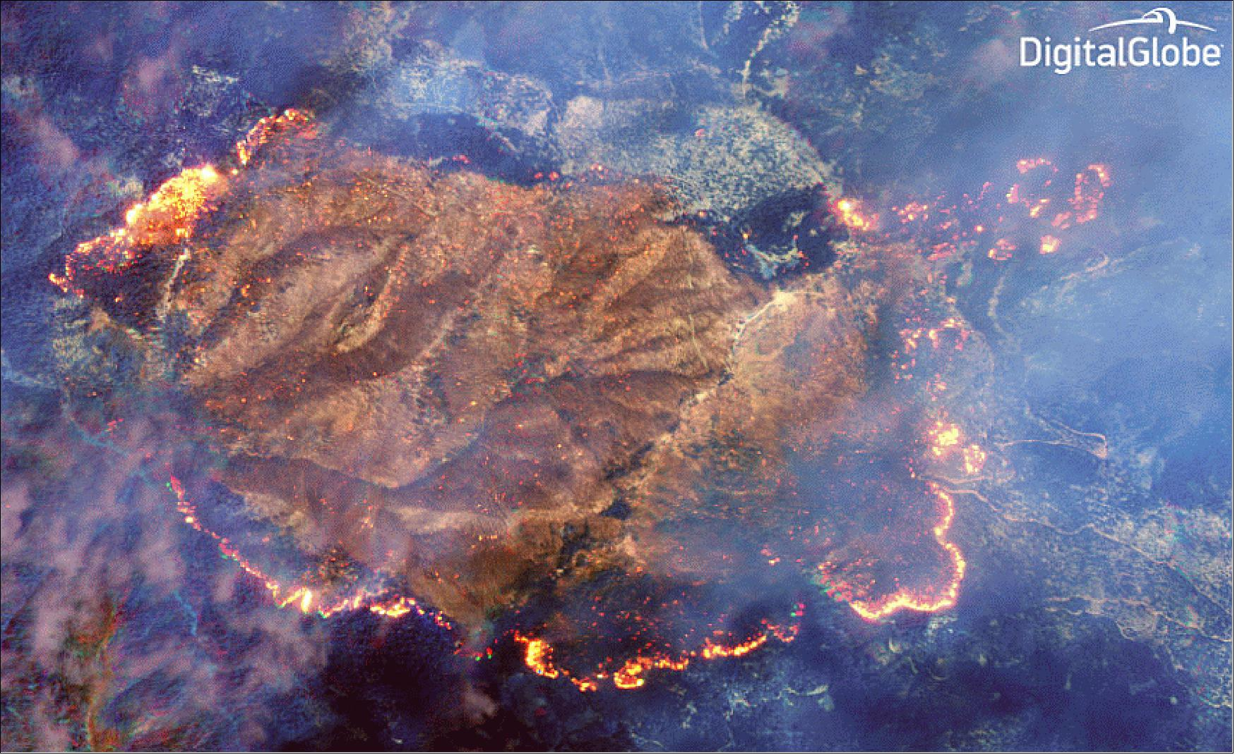
SWIR Image, Klamath Fire

Slide 7
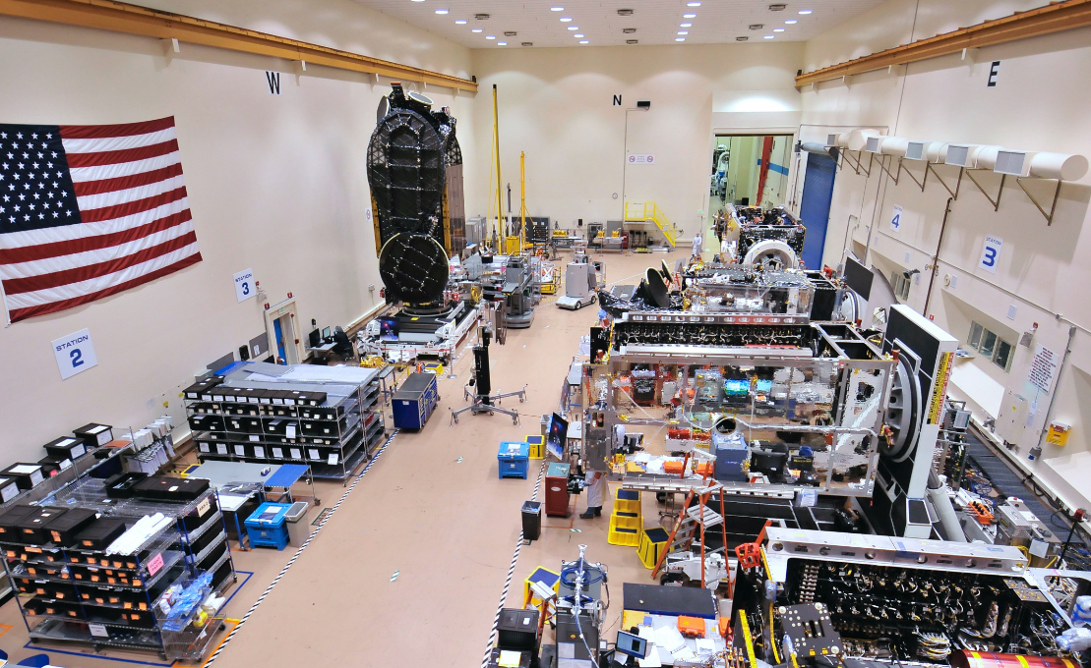
Satellite Clean Room
Notes:
Image of the satellite factory.
Note size of satellite (compared to doors)
Different stations arranged throughout the room
Can move SV from station to station to assemble and checkout

Slide 8
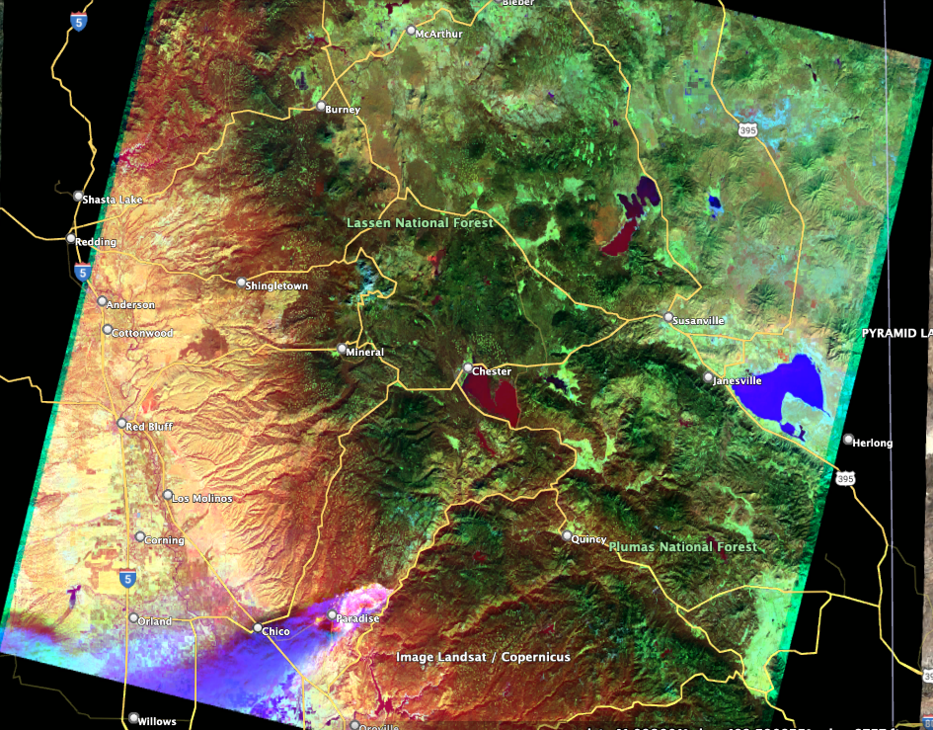
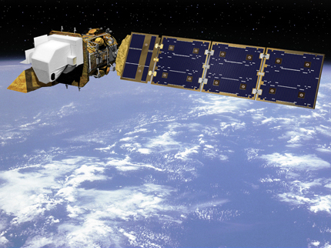
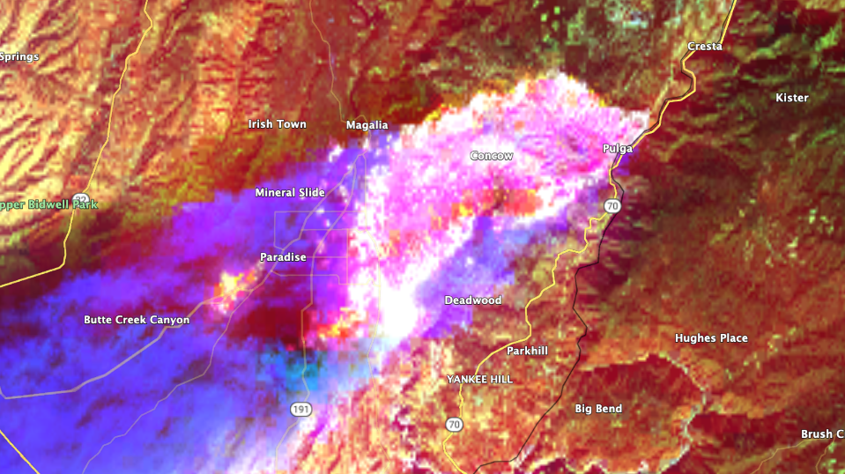
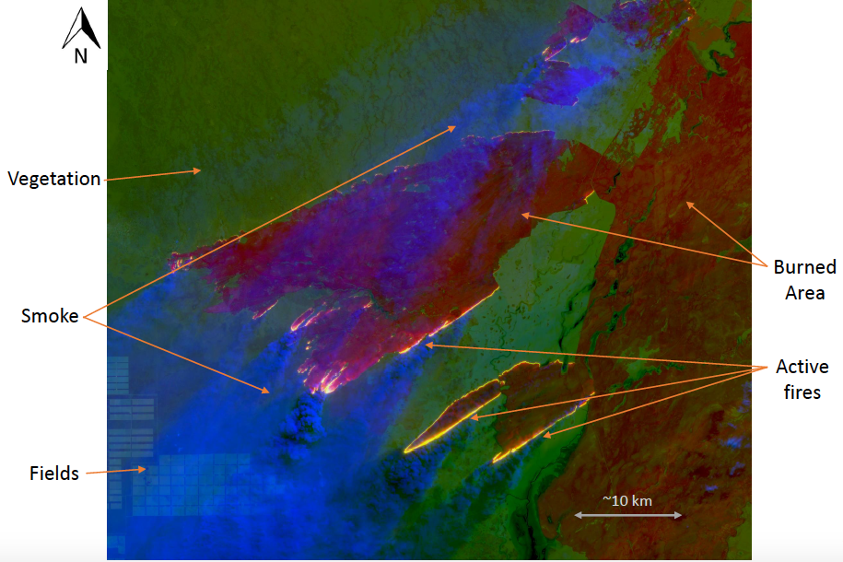
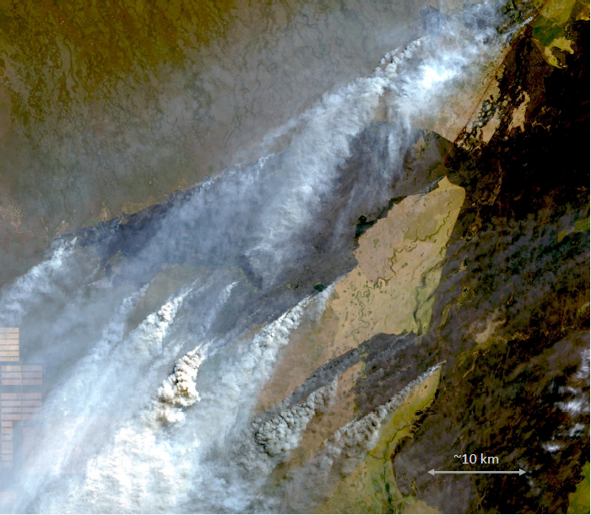
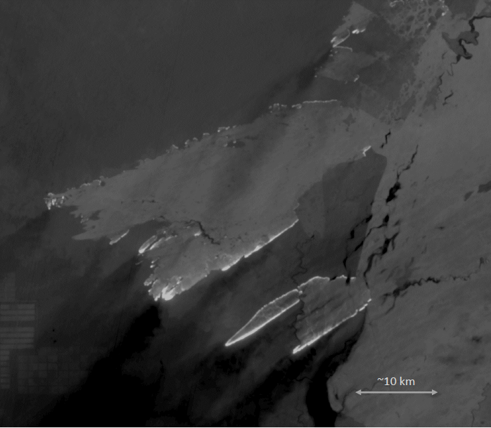
Landsat 8

Slide 9
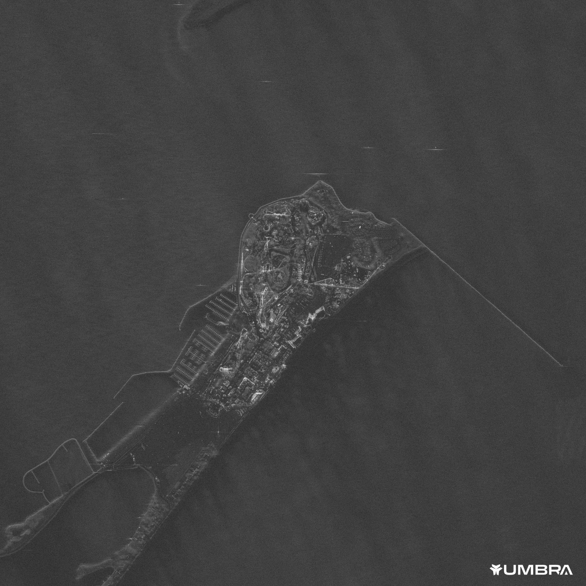
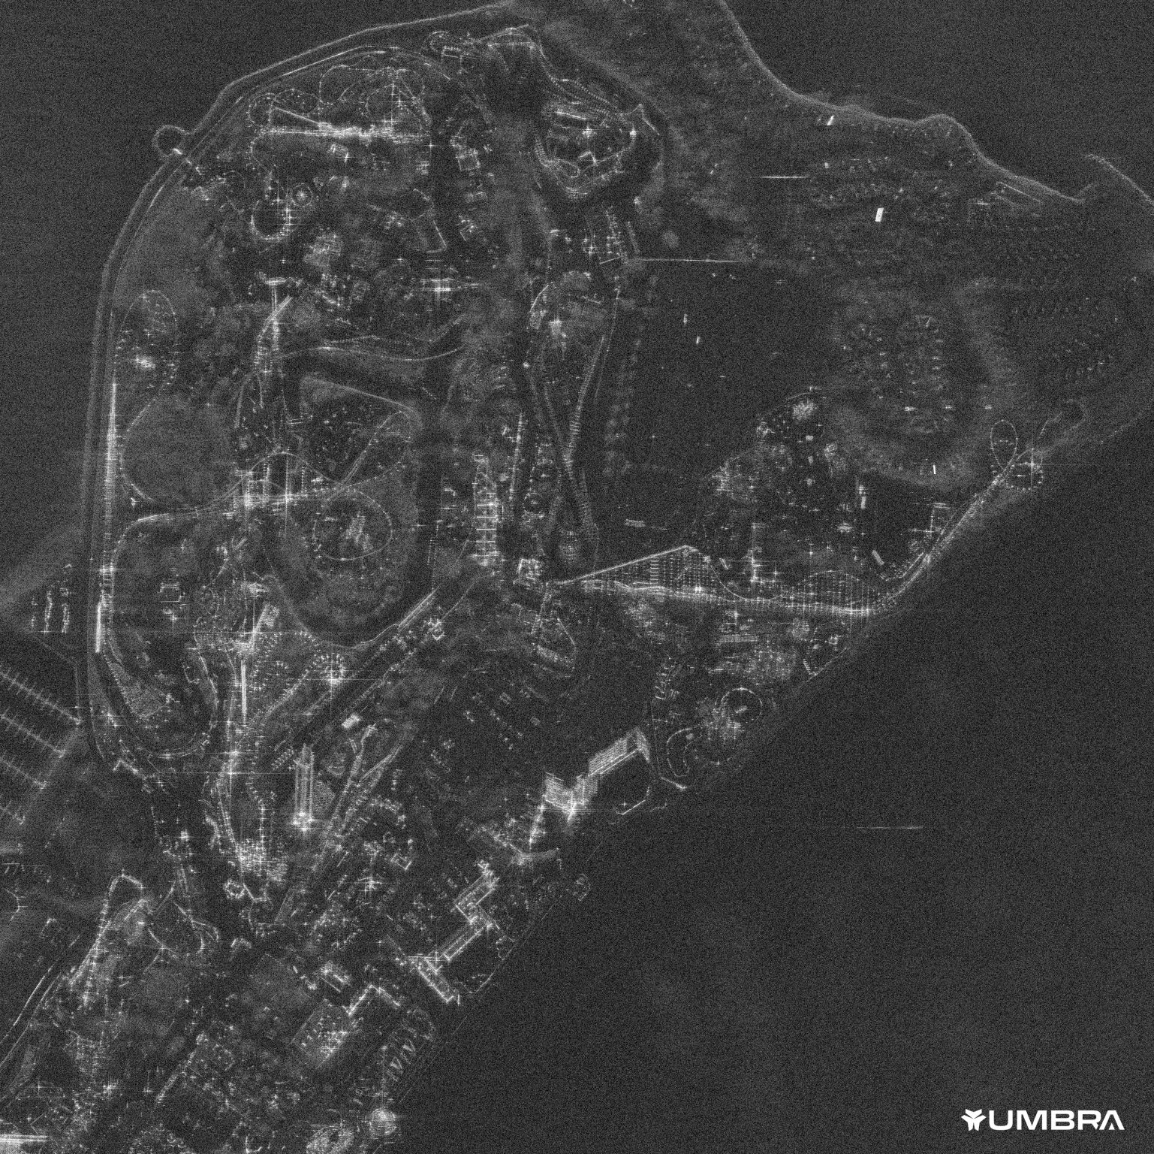
Cedar Point, Sandusky Ohio, USA

Slide 10
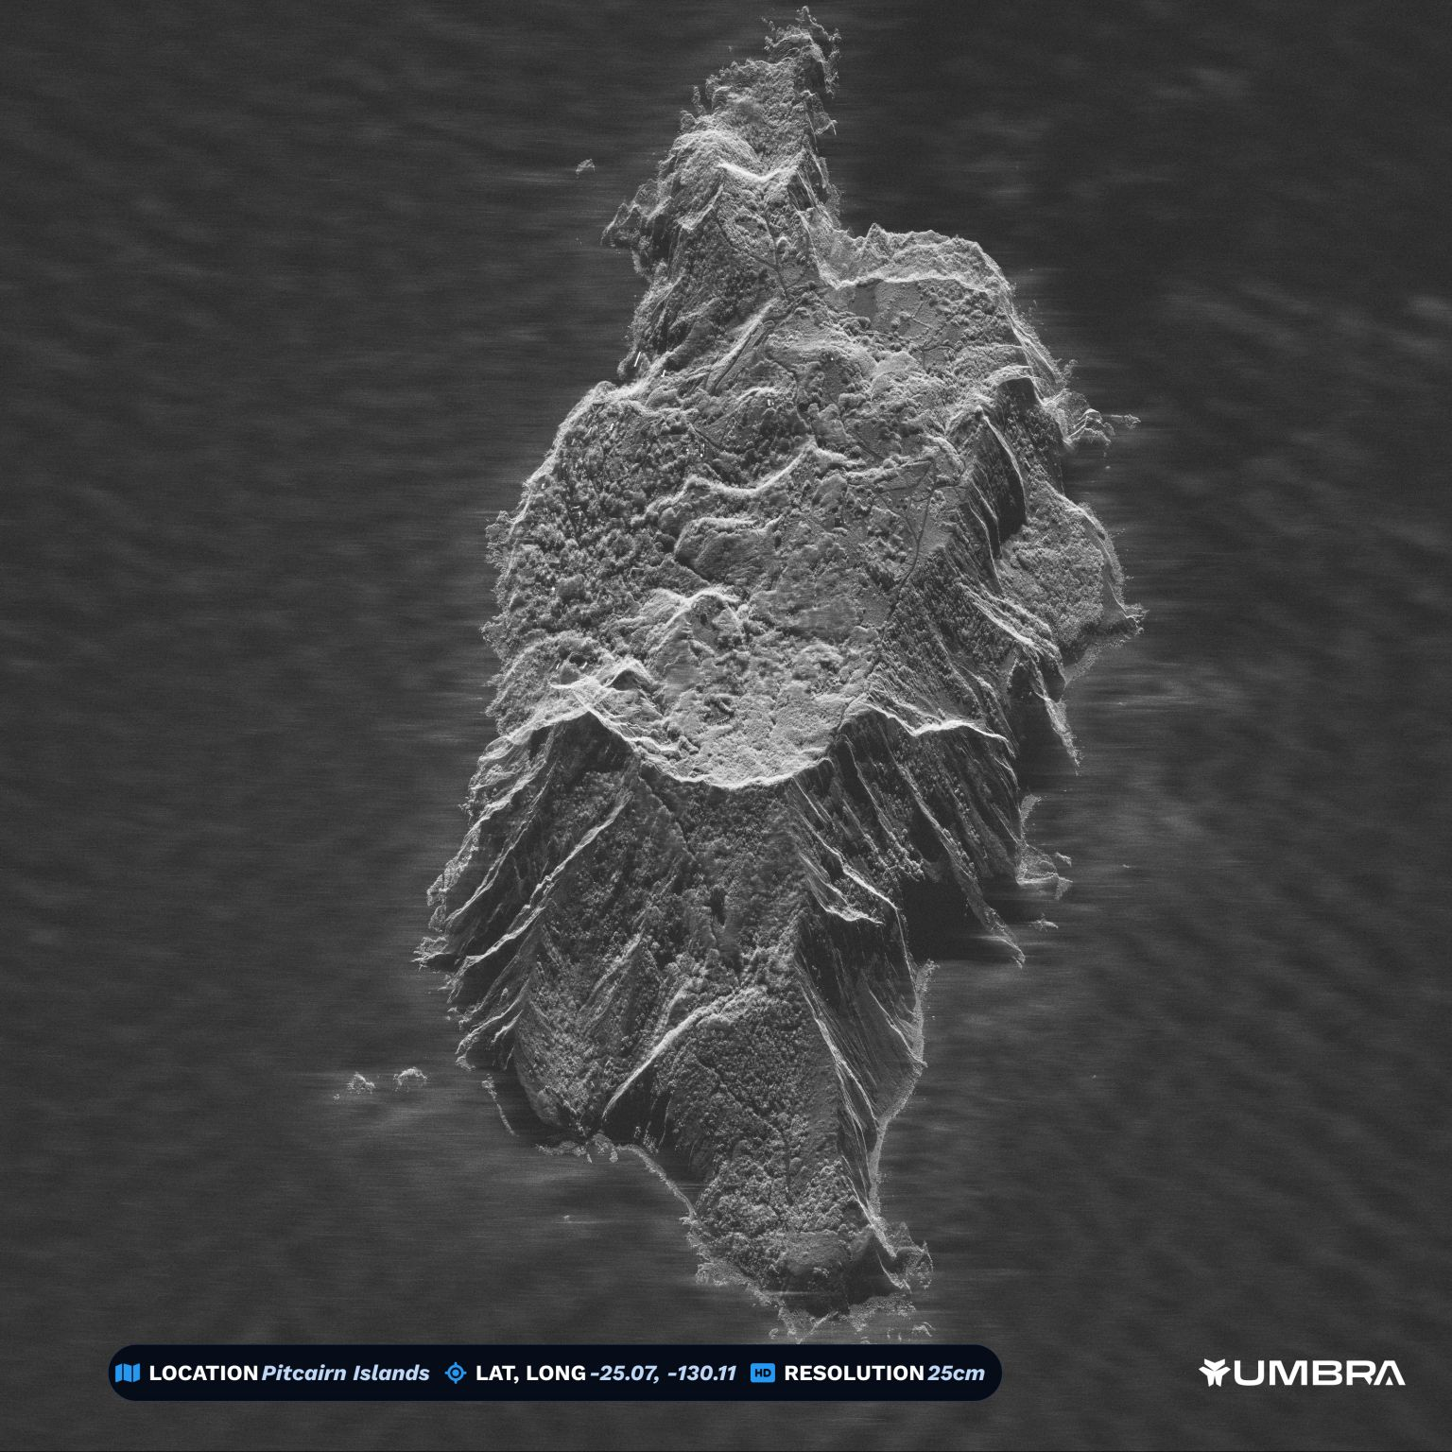
Distortions: Foreshortening, Layover

Slide 11
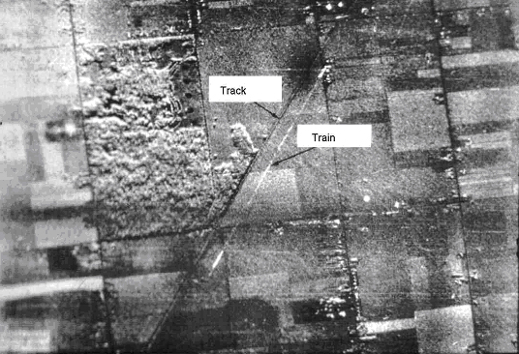
Distortions: Moving objects
Blur and displacement of moving object – movement in both azimuth and ground range directions

Slide 12
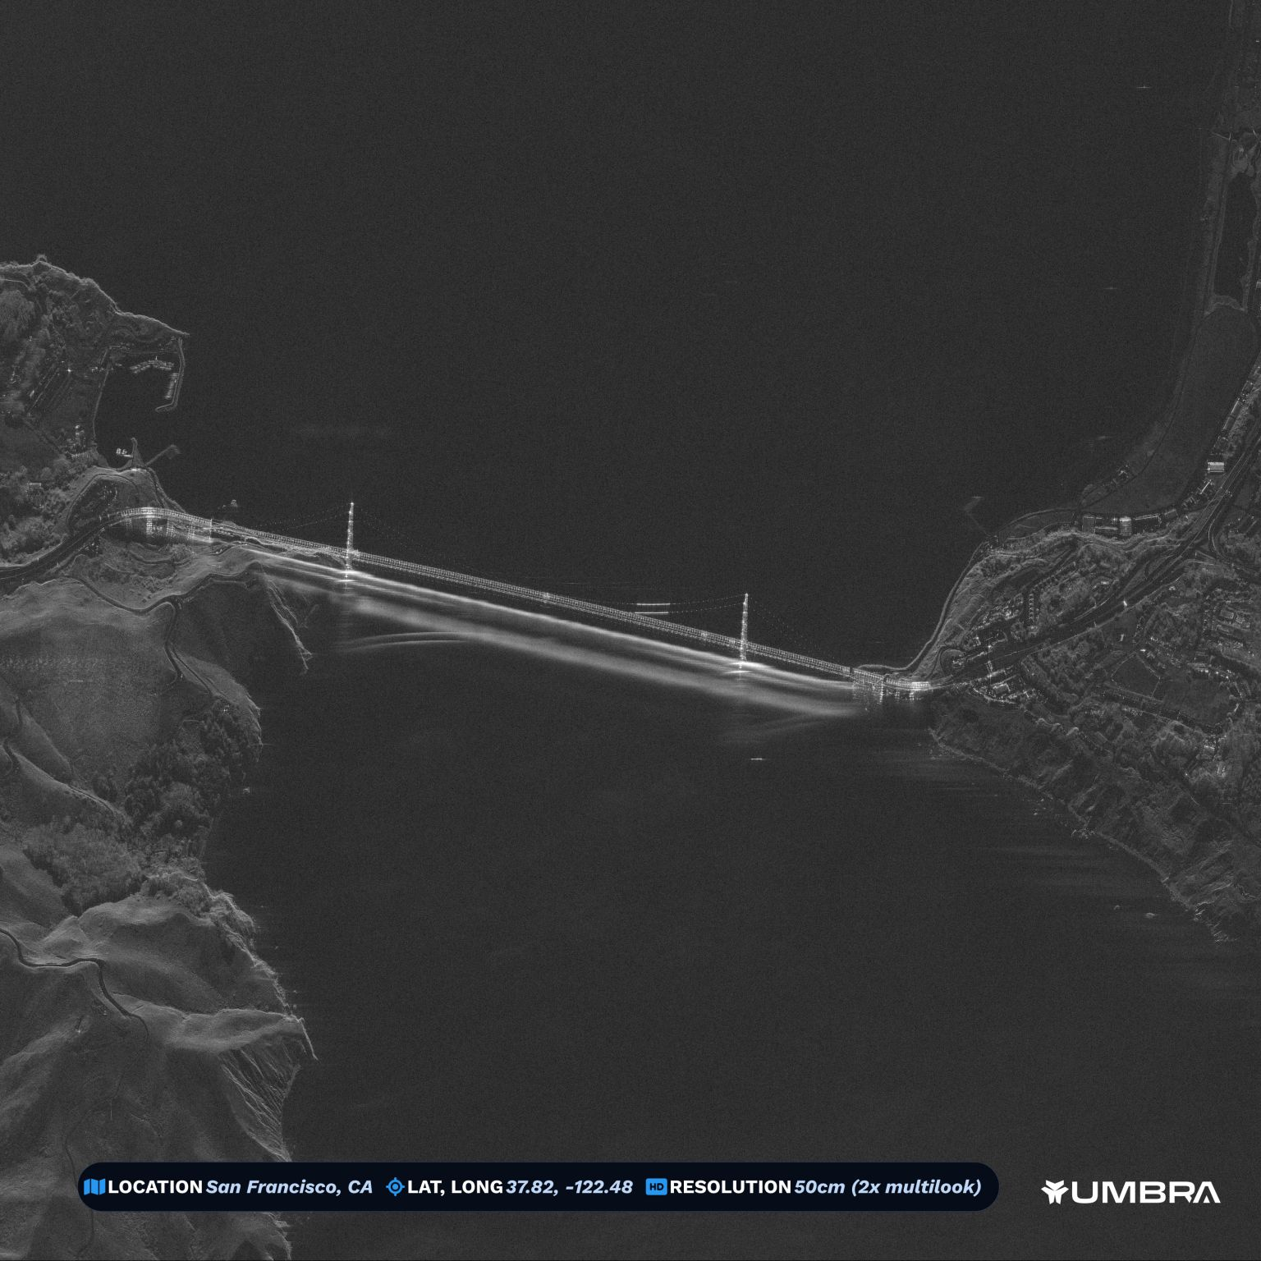
Distortions: Moving objects

Slide 13
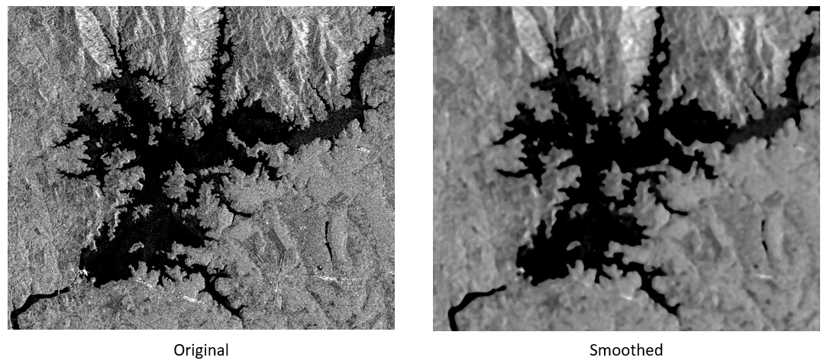
Distortions: Speckle

Slide 14
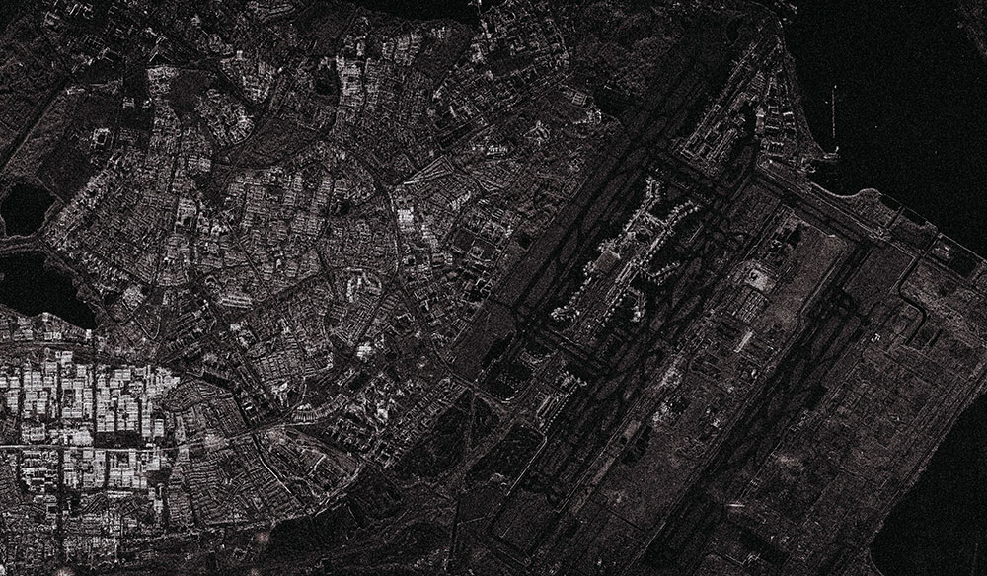
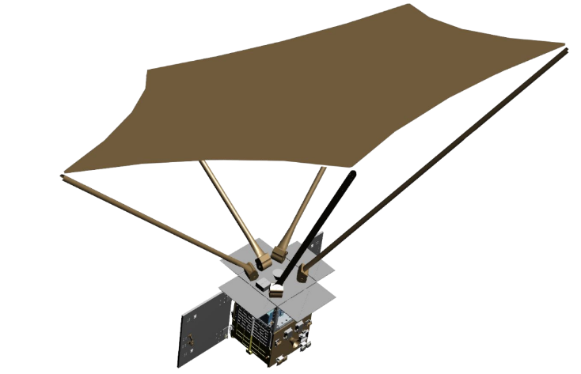
NeuSAR Image of Eastern Singapore (2022)

Slide 15
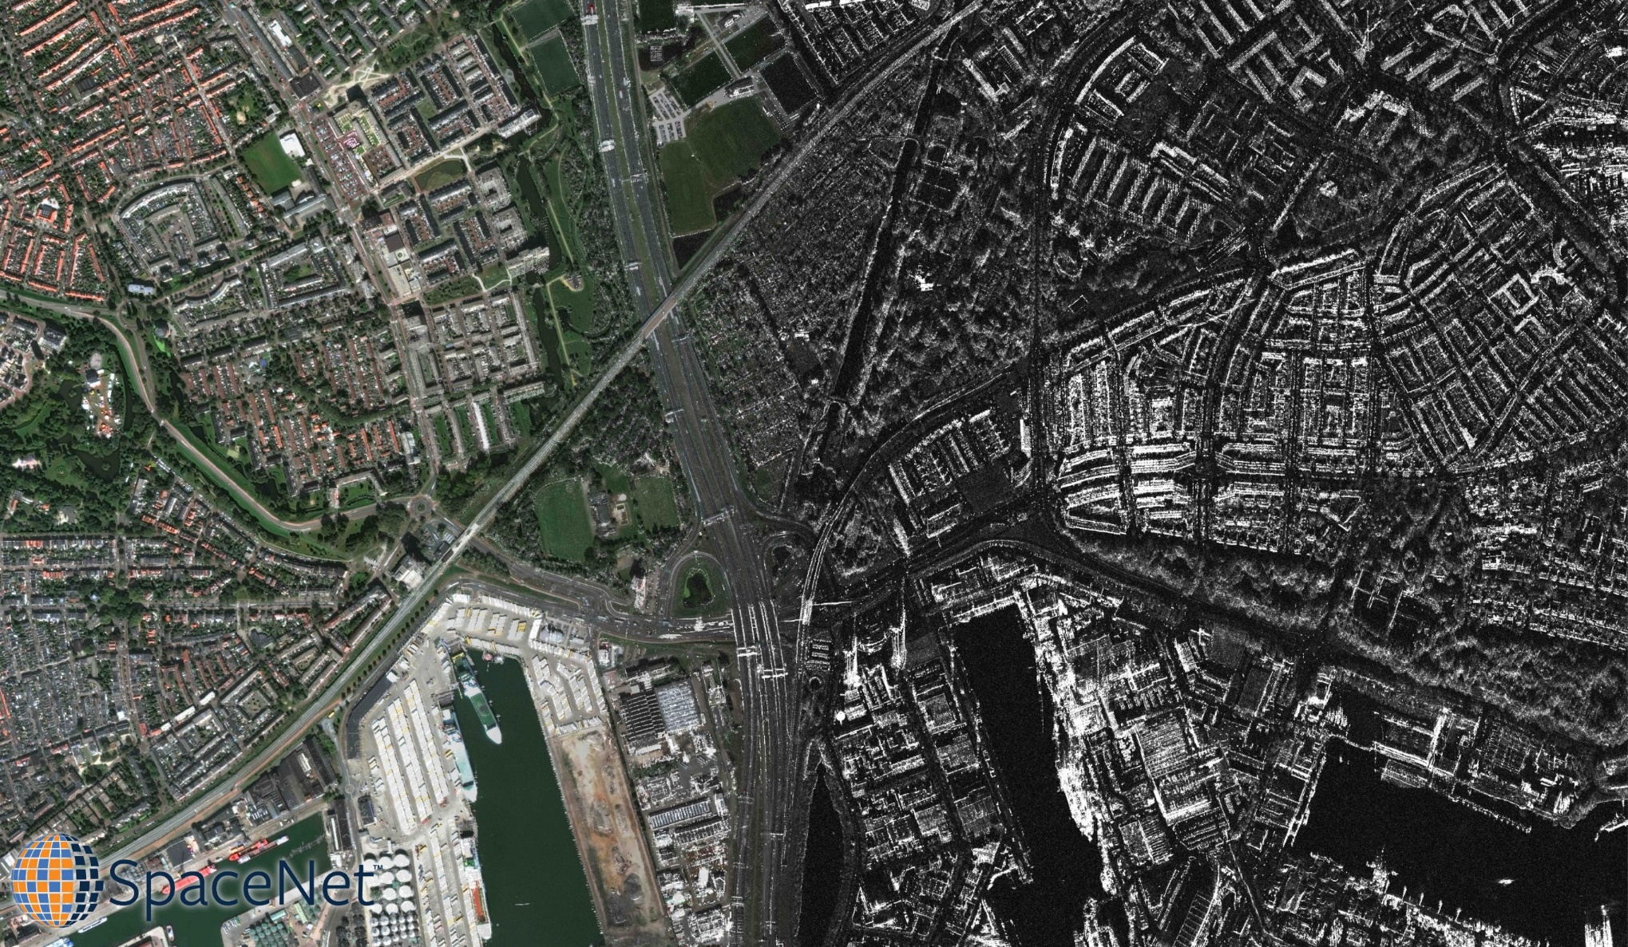
Visible/SAR Comparison
Maxar WorldView 2 imagery (left) blended into Capella Space visualized return (right). Mosaic created by CosmiQ Works.

